Slide 1
Agenda
Start | End | Item
 |  | Logistic Regression
 |  | Break

Slide 2


Supervised Learning
Inferring a function from labeled data.
“Learn from telling”, “Look at my data and I will tell you what to predict”
Data Setup
Algorithm
Business Context
Application
Marketing-Will a customer buy yes or no? How much will a customer spend?
Operations- Will an applicant default? When will a machine break?
Sports Analytics- How many points will the Bears’ QB score? What is the Bears’ probability of winning?
Requires expertise and stakeholder buy in
Flat “Excel” file. Each row is a record or observation. Each column is an attribute of the record.
One column is the outcome, y or target attribute.
Modeling e.g. K-NN, linear regression, decision tree, random forest etc.
Use the model to make predictions for the target label on the new data.

Slide 3
Logistic Regression
Extends idea of linear regression to situation where outcome variable is categorical
Instead of ordinary least squares, β are derived through an iterative process called maximum likelihood estimation
We focus on binary classification
i.e. Y=0 or Y=1

Slide 4


Regression Equation Review
Regression
How Many Cones?
#
= $β$ + $β$*temperature + $β$*day + $β$*price + error

Slide 5
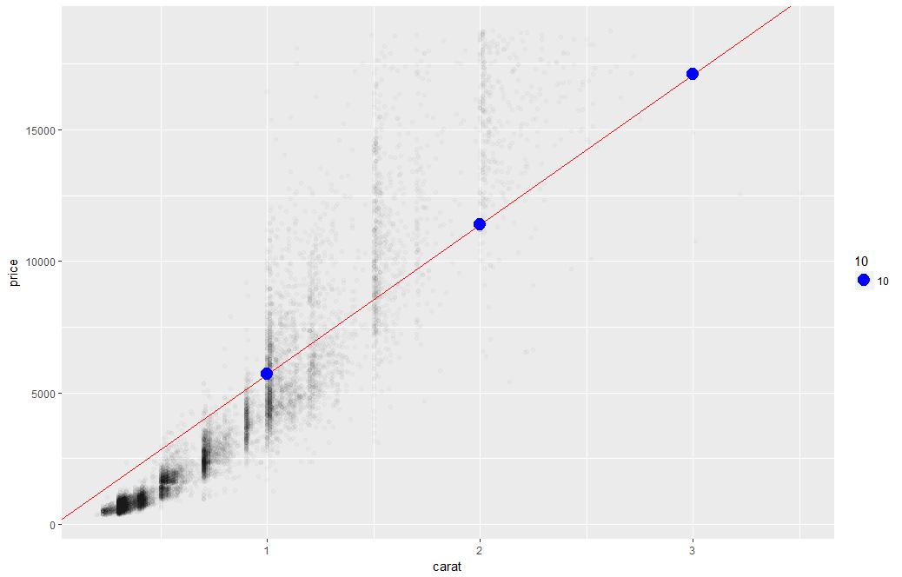
Linear Regression
The predictions is continuous…it continues forever.

Slide 6
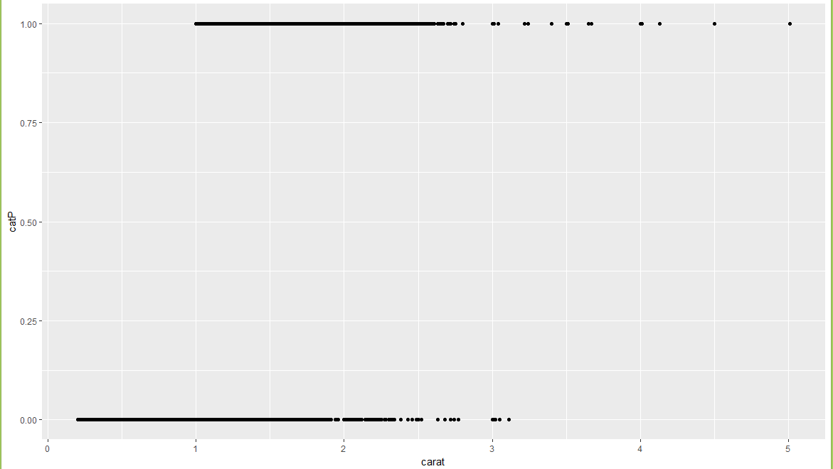
A binary relationship between carat and price
Diamonds above or below $11K

Slide 7
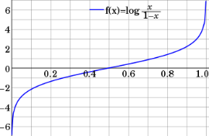

Step 1: Logistic Response Function
Regression
How Many Cones?
#
= $β$ + $β$*temperature + $β$*day + $β$*price + error
Logistic Regression
Will they buy a cone Y/N?
Logit of
= $β$ + $β$*temperature + $β$*day + $β$*price + error
We will let R handle calculating the equation output logOdds to the more understandable probability.

Slide 8
Let’s see the difference in practice
﻿Open A_lm_for classes.R

Slide 9
A binary relationship between carat and price
Diamonds above or below $11K
If the data only has two values, 0/1 but the regression equation goes to infinity.
This makes no sense!
“is this diamond worth more than $11K or not.” Predicting 2 means 2 yes’es?

Slide 10
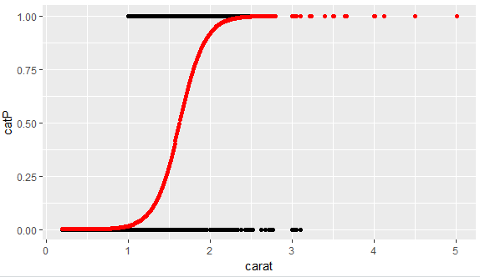
1.
What is the log-odds of the price above $11K? = Beta + Beta*Carat
2. Convert to probability with logistic response function (e^l / (1+e^l)
3. The probabilities are more intuitive than the log-odds from the equation.

Slide 11
From probability to class, define a cutoff threshold.
0.50 is popular initial choice
Additional considerations (see Chapter 5)
Maximize classification accuracy
Maximize sensitivity (subject to min. level of specificity)
Minimize false positives (subject to max. false negative rate)
Minimize expected cost of misclassification (need to specify costs)
If a team has a probability of .25 classify them as a loser.
If a team has .50 or more classify them as a winner

Slide 12

NCAA Classification Madness
College Basketball
Annual 64 team tournament
Business Impact:
$1B wagered
$2B in lost productivity
Bragging Rights
Objective: Identify the probability of a team winning in Round 1.

Slide 13

My friend Mandy is next level.
https://fivethirtyeight.com/features/how-a-data-scientist-whod-never-heard-of-basketball-mastered-march-madness/

Slide 14
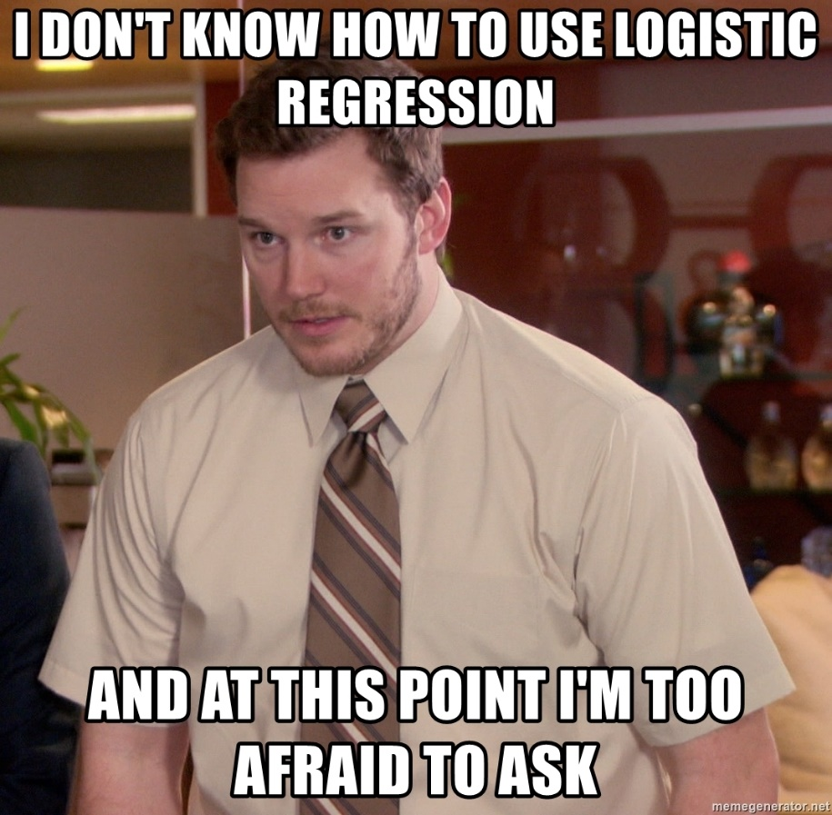
Let’s practice
Open B_fullyMarchMadness.R

Slide 15
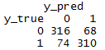
Evaluating a Classification
Confusion Matrix
The model predicted losers 390 (316 + 74) times
The model was correct 316 times for losers
The model predicted 378 winners (68+310)
The model was correct 310 times for winners
As you progress in your data science education, learning other KPI (Recall, Precision, AUC etc) in the book is worthwhile. In this course we stick with the basic accuracy.

Slide 16
Logistic Regression Summary
Logistic regression is similar to linear regression, except that it is used with a categorical response
The predictors are related to the response Y via a nonlinear function called the logit
As in linear regression, reducing predictors can be done via variable selection
Logistic regression can be generalized to more than two classes
libray(nnet)
multiNomialLogit <- multinom(y ~ ., df)

Slide 17
Back to the script
Open B_fullyMarchMadness.R

Slide 18


Your Data Mining Toolbox
Previous Lessons
Some R Programming (R-studio)
EDA (summaries, column and row exploration)
Knowledge of Data Preparation (vtreat)
Basic Visualization (plot, ggplot)
Regression (continuous predictions)
After today
Binary Classification (logistic regression)
Regression & Logistic Regression are two good starting algorithms . Both put you on a path to more complex machine learning but more importantly you can start to frame business problems in terms algorithms can understand.

